Slide 1
The workspace
What comes before the architecture!
Oualid Ktata

Slide 2
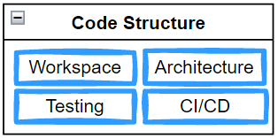
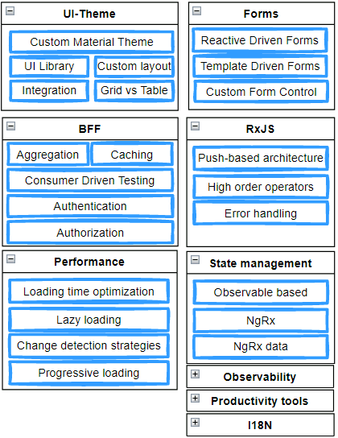
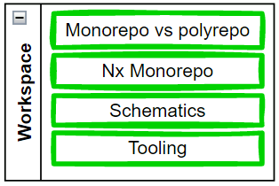
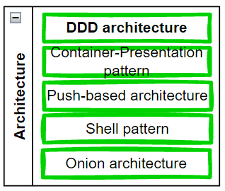
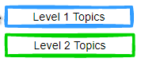
Context- Today’s topic and future topics

Slide 3
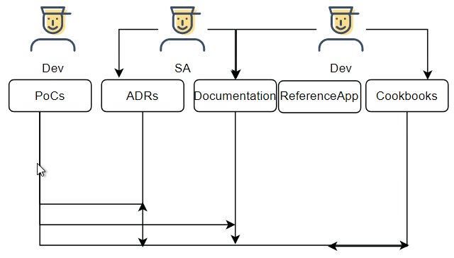
Context-Reminder of the process
Notes:
Now that we have the context, let’s get started…

Slide 4
EXPORT CLASSIFICATION
x
Check this box if presentation contains “no technical data” OR summarize the export classifications of all slides in this presentation as instructed below:
Instructions: Box 1 and one (1) of boxes 2-5 must always be completed
 | Classification:
1. Canadian ECL(s):
2. ECCN(s) (EAR):
3. P-ECCN(s) :
4. USML (ITAR):
5. P-USML:
PROPRIETARY NOTICE
This document is the property of Pratt & Whitney Canada Corp. (“P&WC”). You may not possess, use, copy or disclose this document or any information in it, for any purpose, including without limitation to design, manufacture, or repair parts, or obtain TCCA, FAA, or other government approval to do so, without P&WC's express written permission. Neither receipt nor possession of this document alone, from any source, constitutes such permission. Possession, use, copying or disclosure by anyone without P&WC's express written permission is not authorized and may result in criminal or civil liability.
4

Slide 5
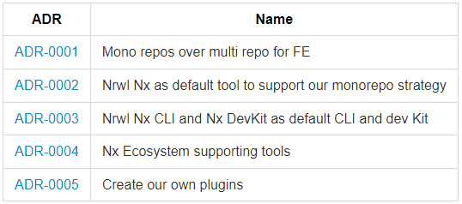
Agenda
1-Enterprise concerns
2-Polyrepos vs Monorepos
3-Nrwl Nx Workspace
4-Tooling
5-Schematics
Notes:
We will cover these areas

Slide 6
1-Enterprise concerns
The larger the system, the …

Slide 7
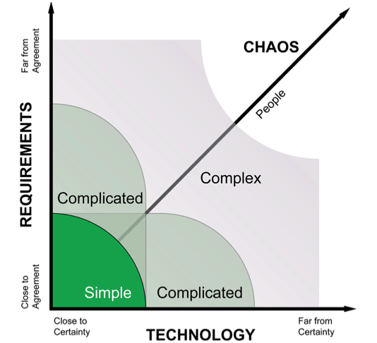
Enterprise applications
Large
Overall complex
+6 months
Longer lifecycle
+teams
Less predictable
Collaboration with external systems
Need to split to manage
Tend to be slower with changes
Requires complex tooling

Slide 8
1-Enterprise concerns
Consistency
Safety
Sustainability
Changing requirements
Notes:
While small projects or apps do not require a deep thinking on how to organize code due to their simplistic nature, enterprise or large projects have more serious concerns that requires a deep understanding because of the huge impact that may have.
Small teams can manage somehow the complexity of small projects. Large teams require more tools and a shift in thinking.
T1-**Consistency** — how do we make sure that everyone in the organization follows the same best practices for structuring and writing code?
coding best practices
application structure
- T2-**Safety** — how do we ensure that our code will not be subject to attacks or prone to errors?
- T3-**Increased size and complexity** — how can we structure our code so that it can grow without sacrificing clarity or performance?
T4-**Changing requirements** — how can we keep up with the demands of the business to continually update the application without letting technical debt get out of control?
Here where mono repos shine…

Slide 9
2-Poly vs Mono repos
For a better developer experience

Slide 10
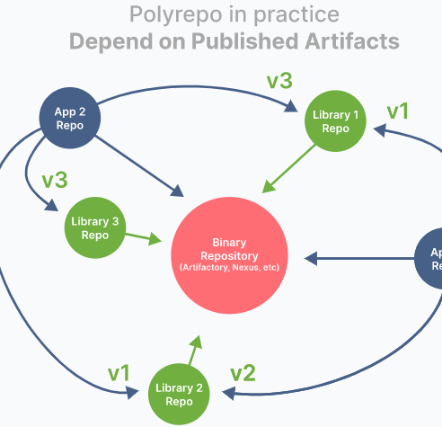
Team autonomy
Full control on their build pipeline
Responsible of the build artefact
Notes:
Polyrepos promotes team autonomy through isolation. Every repo potentially holds an app or a library.
Dependencies are then shared through published artefacts…. In front-end, this means more NPM packages.
Most likely, you have already noticed, one of the major pain points of poly repos for developers: dependency hell!.
Collaboration, becomes tedious when trying to upgrade to a newer version. Developers have no visibility on the impact of affected changes to their own repo. Some drastic solutions are available such as MF. But they also come at cost, this time performance.
TRANSITION: Let’s have a look at more drawbacks of polyrepos….

Slide 11
Drawbacks of polyrepos
Dependency hell
A lot of effort to share reusable components: Own CI & tooling
Significant code duplication because painful to share
Several PRs for one change: Costly changes
Every Repo has its own tooling
Notes:
**Cumbersome code sharing**: To share code across repositories, you'd likely create a repository for the shared code. Now you have to set up the tooling and CI environment, add committers to the repo, and set up package publishing so other repos can depend on it. To this there will be extra effort on reconciling **Incompatible versions** of third party libraries across repositories.
- **Significant code duplication**: No one wants to go through the hassle of setting up a shared repo, so teams just write their own implementations of common services and components in each repo. This **wastes up-front time**, but also increases the **burden of maintenance, security, and quality control** as the components and services change.
- **Costly cross-repo changes to shared libraries and consumers**:Consider a critical bug or breaking change in a shared library: the developer needs to set up their environment to apply the changes across multiple repositories with **disconnected revision histories**. Not to speak about the **coordination effort** of versioning and releasing the packages.
- **Polyrepo Inconsistent tooling**: Each project uses its own set of commands for running tests, building, serving, linting, deploying, and so forth. Inconsistency creates **mental overhead** of remembering which commands to use from project to project.

Slide 12
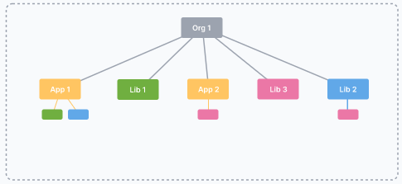
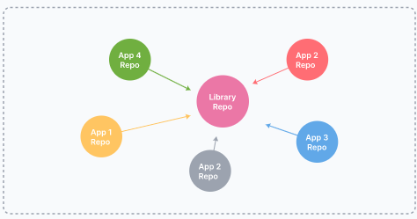
Mono vs Poly
Monorepos
Polyrepos

Slide 13
Monorepos answer
Simplified Dependency management
Atomic commits: 1 PR across projects
Same DX across the organization: Tool Consistency
Better collaboration btw teams
One version policy
Notes:
- **Easier dependency management**: Only one **package.json**. No need to re-install dependencies in each repo whenever you want to update your dependencies.
- **One version of everything**: No need to worry about incompatibilities because of projects depending on conflicting versions of third party libraries.
- **Re-use code with shared projects while still keeping them isolated**: Monorepo allows you to reuse your packages from other packages while keeping them isolated from one another.
- **Easily refactor global features with atomic commits**. Instead of doing a pull request for each repo, figuring out in which order to build your changes, you just need to make an atomic pull request which will contain all commits related to the feature that you are working against.
- **Atomic commits across projects**: Everything works together at every commit. There's no such thing as a breaking change when you fix everything in the same commit.
- **Developer mobility**: Get a consistent way of building and testing applications written using different tools and technologies. Developers can confidently contribute to other teams’ applications and verify that their changes are safe.
- **One place to store all configs and tests**. Since everything is located inside one repo, you can configure your CI/CD and bundler once and then just re-use configs to build all packages before publishing them to remote. Same goes for unit, e2e, and integration tests—your CI will be able to launch all tests without having to deal with additional configuration.
- **No overhead to create new projects**: Use the existing CI setup, and no need to publish versioned packages if all consumers are in the same repo.

Slide 14
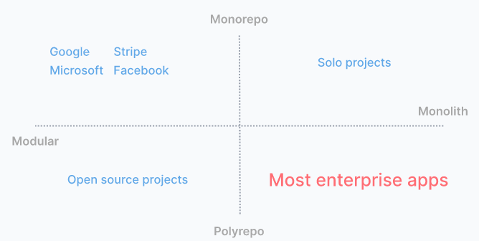
Adopters
Notes:
We want to go from the bottom right of the spectrum to the top left of the spectrum.
In the next slides, we will answer why we want to join them and how we can do it at our own pace and our own way, simply because we are not google or facebook and we don’t have the same resources. Though I wish we have.
Let’s get started…

Slide 15
Need for tooling
Fast
Manageable
Understandable
- Local computation caching
- Local task orchestration
- Distributed computation caching
- Distributed task execution
- Transparent remote execution
- Detecting affected projects/packages
- Code sharing
- Consistent Tooling
Code generation
Project constraints and visibility
- Workspace analysis
- Dependency graph
Notes:
- **Local computation caching**: The ability to store and replay file and process output of tasks. On the same machine, you will never build or test the same thing twice.
- **Local task orchestration**: The ability to run tasks in the correct order and in parallel. All the listed tools can do it in about the same way, except Lerna, which is more limited.
- Distributed computation caching : The ability to share cache artifacts across different environments. This means that your whole organization, including CI agents, will never build or test the same thing twice.
- Distributed task execution:The ability to distribute a command across many machines, while largely preserving the dev ergonomics or running it on a single machine.
- Transparent remote execution: The ability to execute any command on multiple machines while developing locally.
- Detecting affected projects/packages:Determine what might be affected by a change, to run only build/test affected projects.

Slide 16
3-Nrwl Nx
Flexible tool

Slide 17
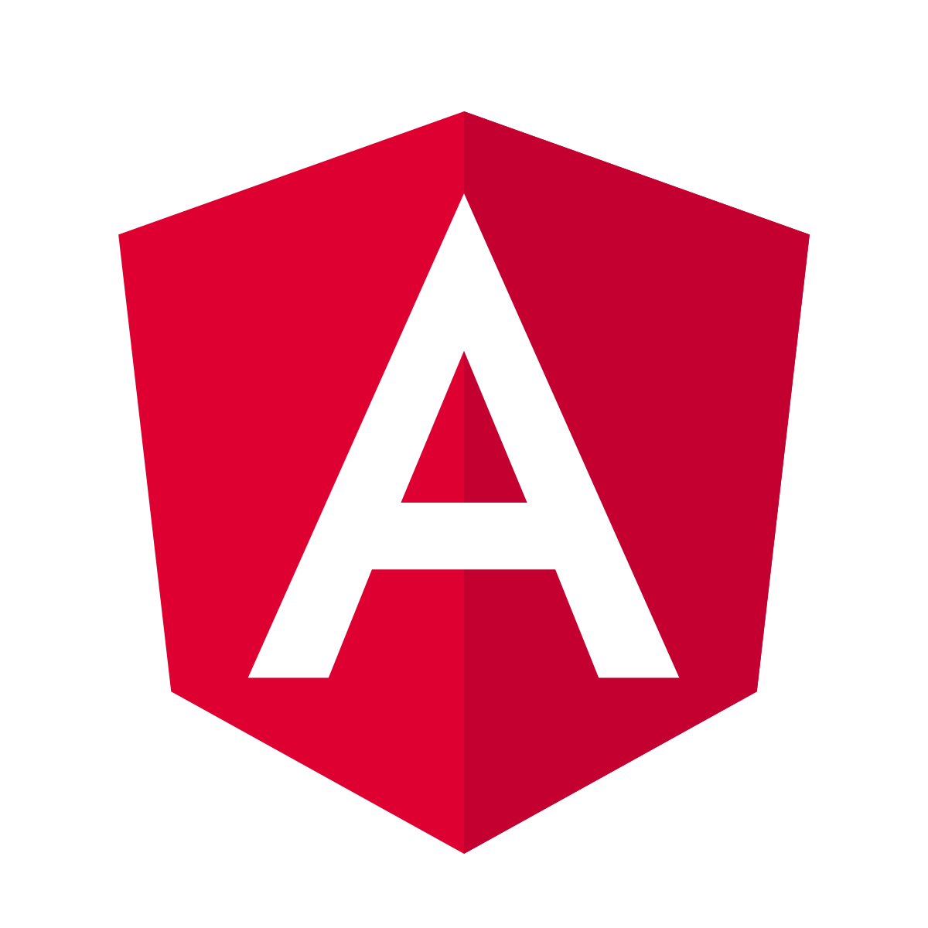

Nx
It’s an extensible build framework that help you architect, test and build at scale.

Slide 18
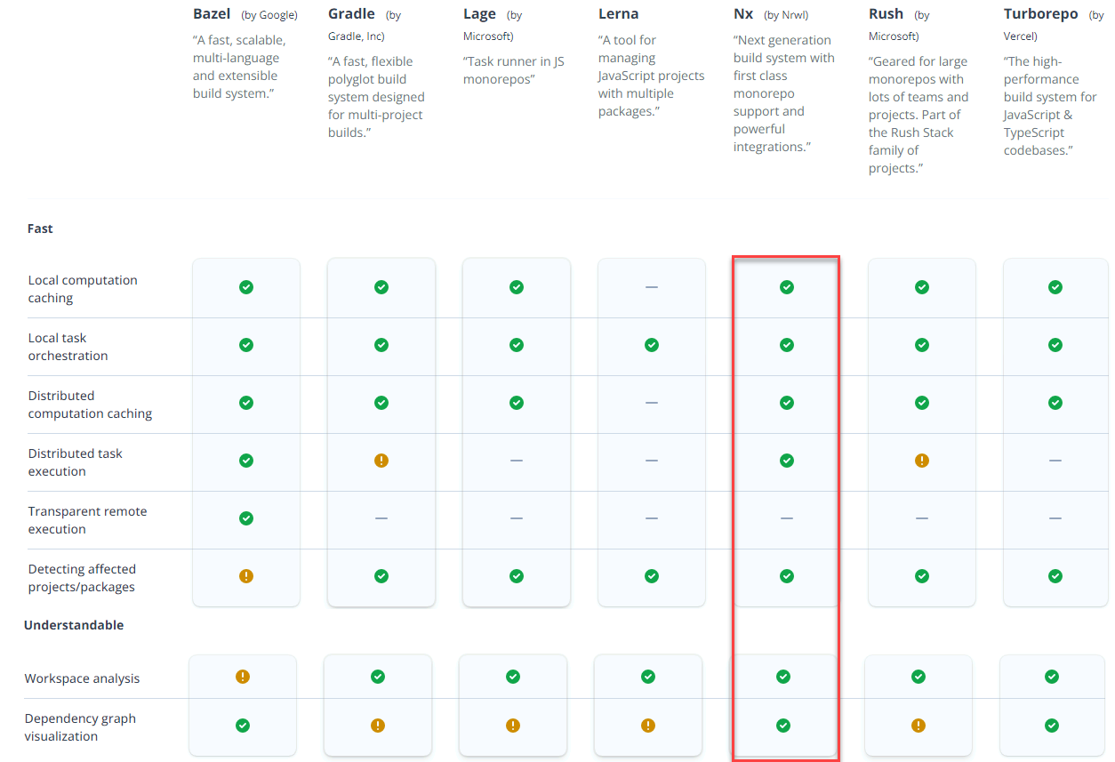

Slide 19
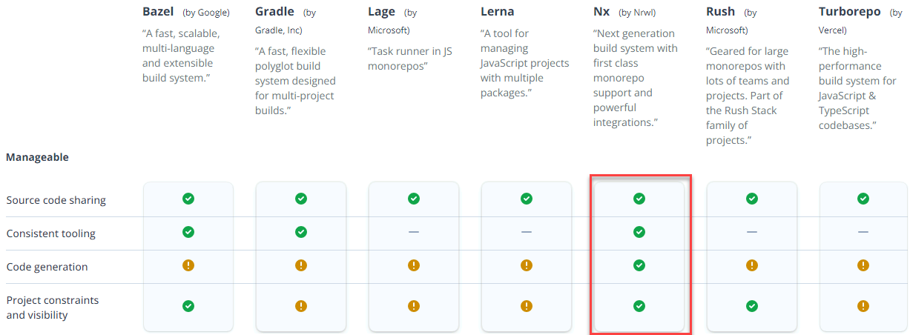

Slide 20

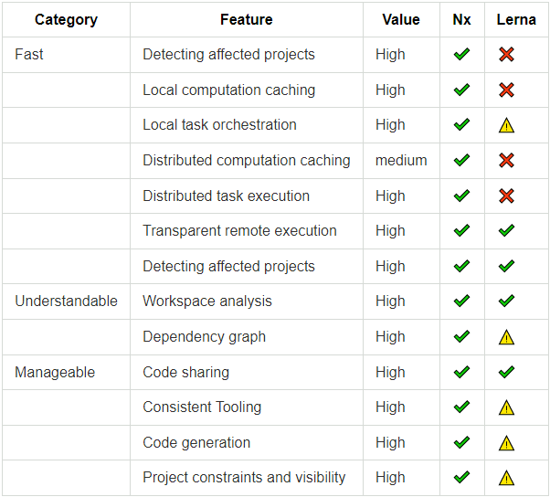
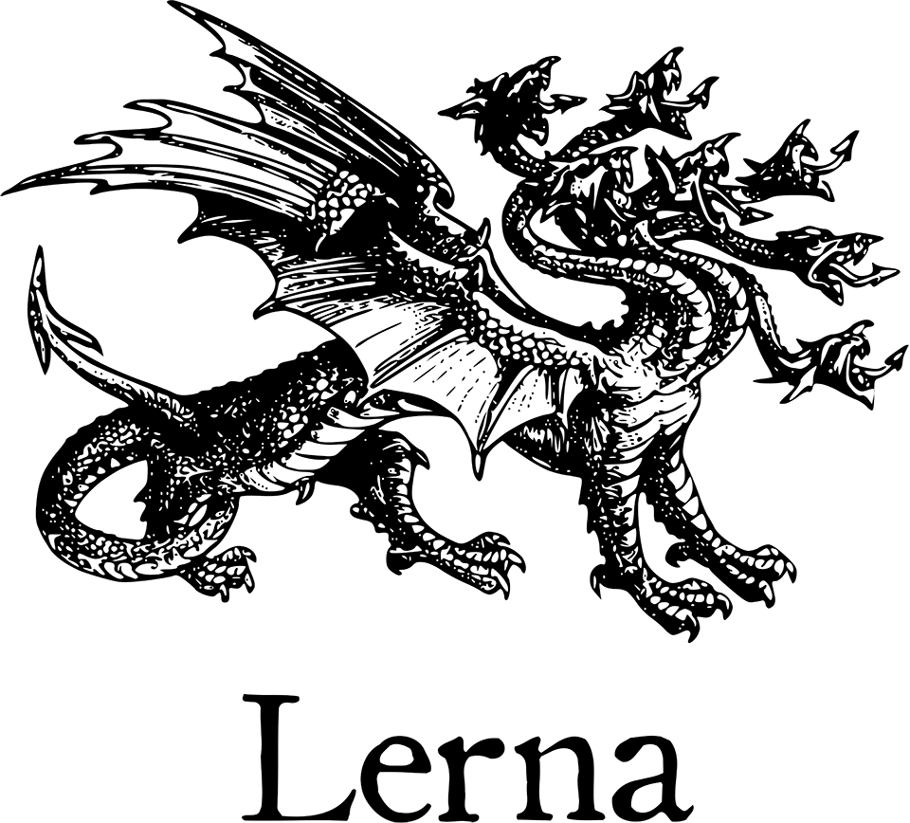
Nx vs && Lerna
Notes:
More on the supporting documentation. The take away, they play nice together!

Slide 21
Nx Benefits
Better Developer Experience
Increased productivity
Better collaboration
Increased compliance to standard
Easier code sharing
Powerful built-in generators
Single Version policy
Enforced architecture
Ability to analyze your source code
Dependency graph
Easy refactoring
Code linting and formatting
Support for best testing frameworks
Powerful
Nx dev-kit
Consistent tooling
Dependency constraints

Slide 22
Nx Considerations
Enforce Trunk-based branching
Restrict access
Frequent/small commits
Adopt Feature flag
Notes:
1-Monorepo-style development only works if we rebuild, retest, and relint only the projects that can be affected by our changes. If we instead retest everything, we will get the the following problems
The time it takes to run the CI checks should be proportional to the impact of the change, not the size of the repo.
We should utilize affected:* commands to build and test projects
2- have a single main branch (say main) where every team submits their code. And they do it as soon as possible.
This is anyway a good practice, we will be promoting a trunk-based branching strategy.
Reasons for
Comparaison: Trunk branch vs development branch vs feature branch

Slide 23
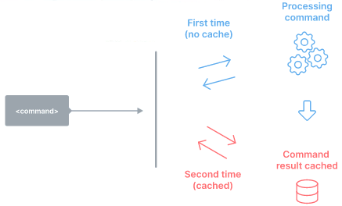
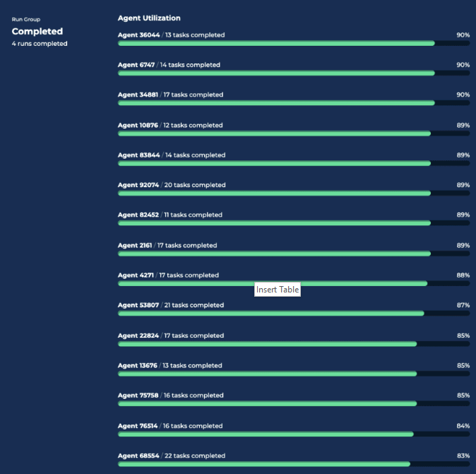
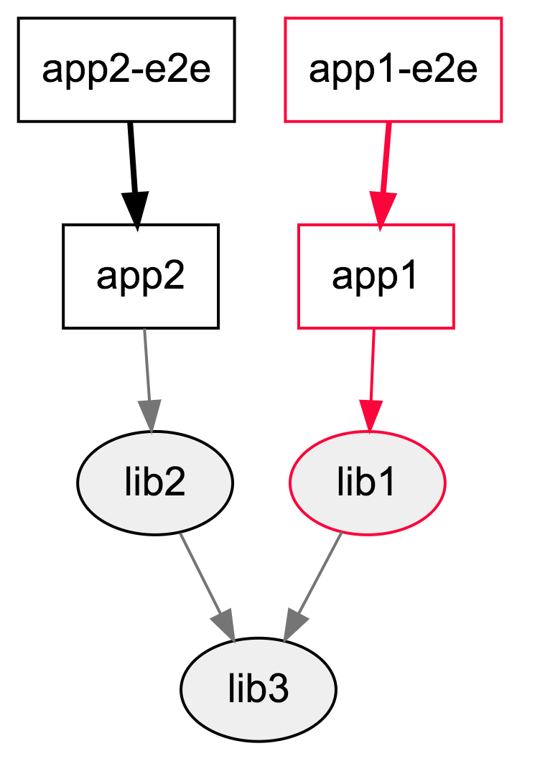
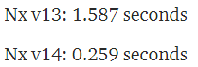
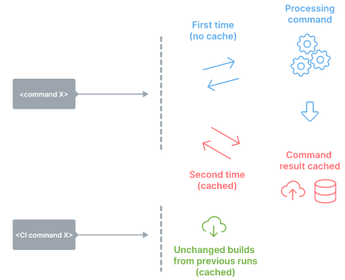
Fast
Distributed task execution
Local computation caching
Affected!
Notes:
- **Code sharing**: Facilitates sharing of discrete pieces source code. Sharing could be done in different ways. For example, Nx allow any folder of files to be marked as a project and can be shared. Nx plugins help configure WebPack, Rollup, TypeScript and other tools to enable sharing without hurting dev ergonomics. In the other hand Lerna supports it only by sharing npm packages.
- **Consistent Tooling**:
The tool helps you get a consistent experience regardless of what you use to develop your projects: different JavaScript frameworks, Go, Rust, Java, etc.
In other words, the tool treats different technologies the same way.
- **Code generation**: Native support for generating code.
- **Project constraints and visibility**:
Supports definition of rules to constrain dependency relationships within the repo. For instance, developers can mark some projects as private to their team so no one else can depend on them. Developers can also mark projects based on the technology used (e.g., React or Nest.js) and make sure that backend projects don't import frontend ones.

Slide 24
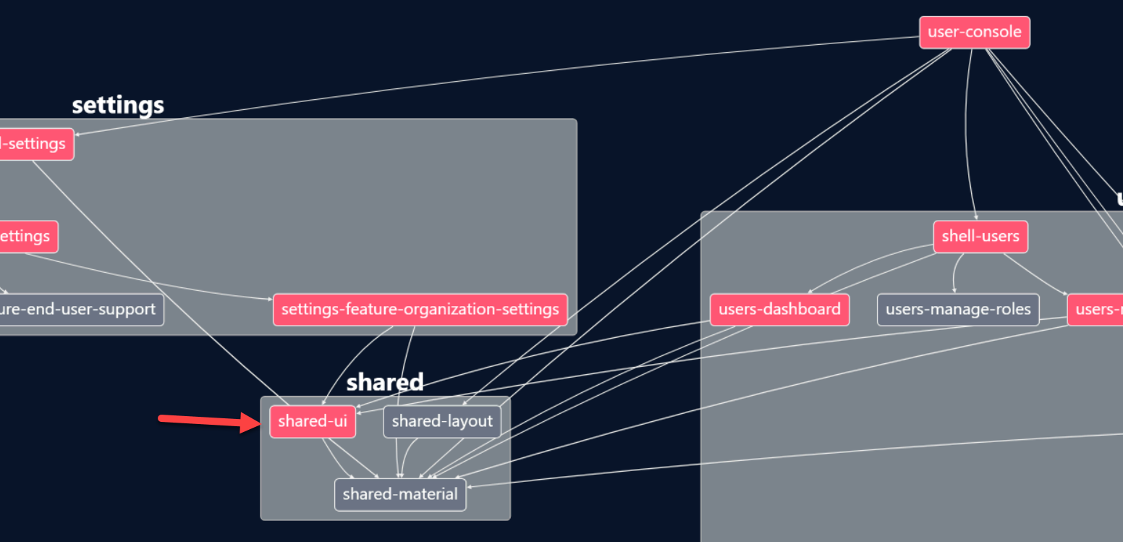
Fast-Detecting affected projects/packages
Notes:
- Detecting affected projects/packages:Determine what might be affected by a change, to run only build/test affected projects.

Slide 25
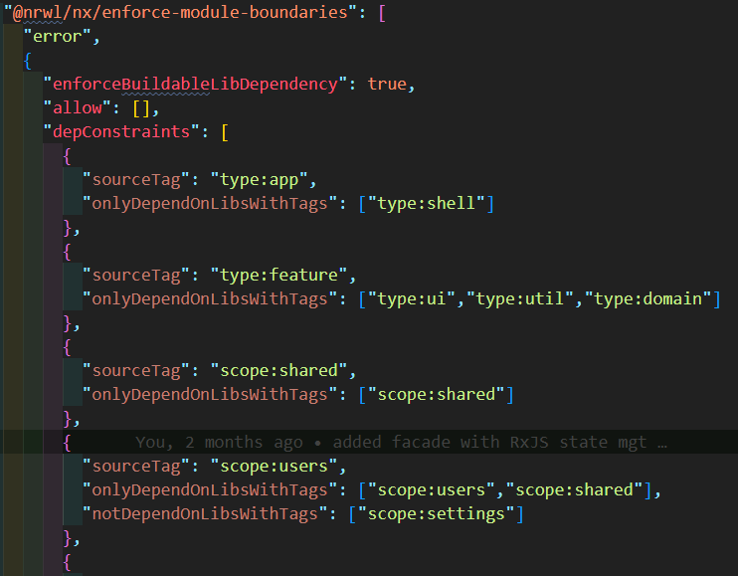
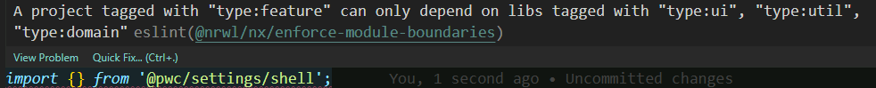
Manageable:Dependencies constraints

Slide 26

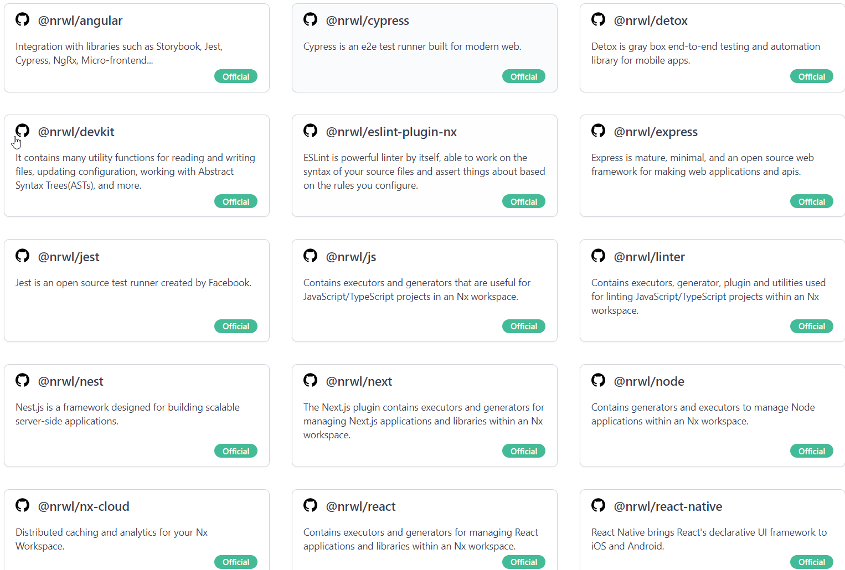
Extensible-Plugins

Slide 27
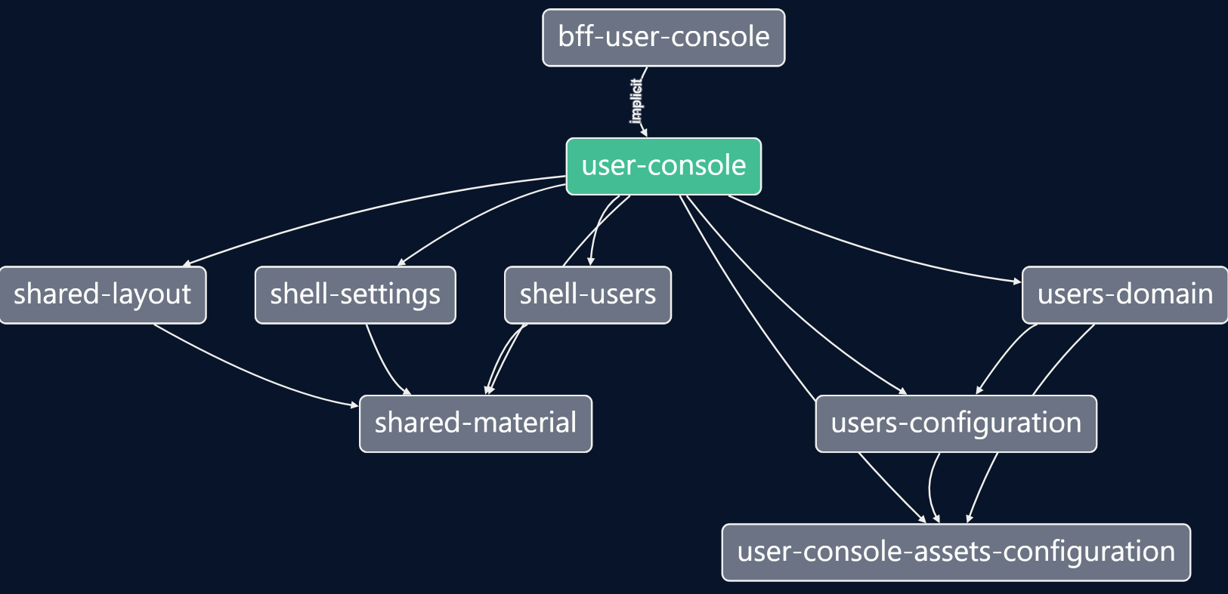
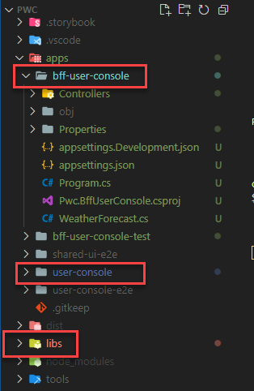
Dot-net extension for BFF support

Slide 28
4-Tooling
Best in class

Slide 29
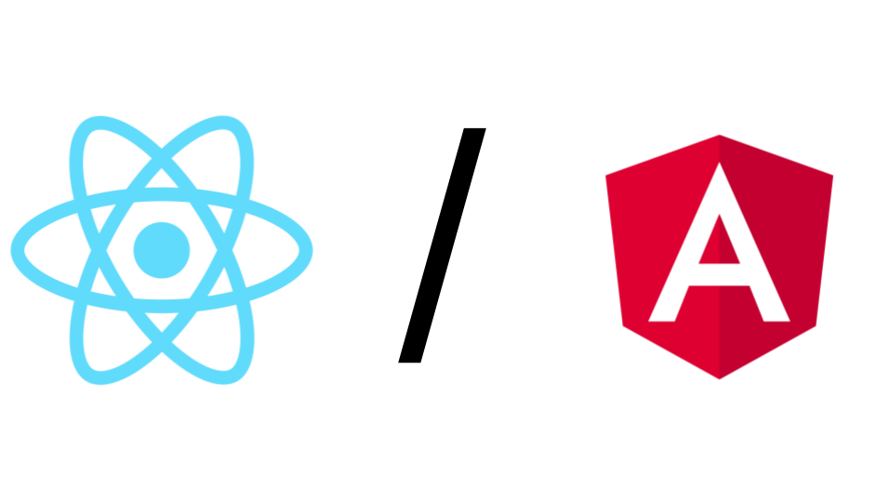
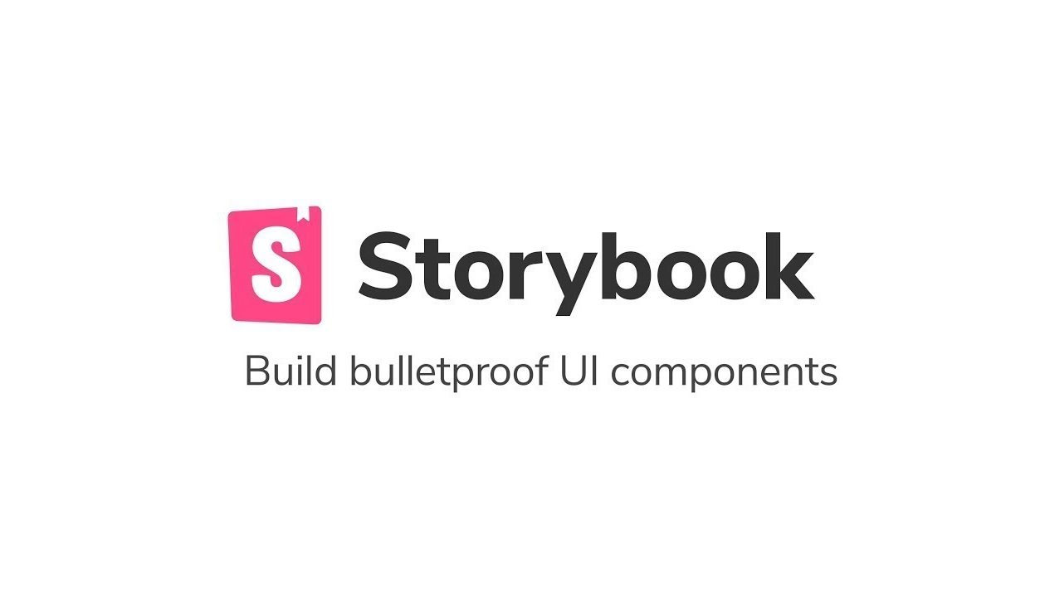

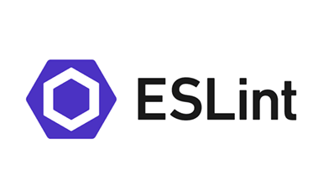
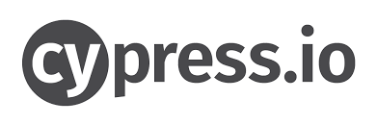
Nx Ecosystem

Slide 30
5-Schematics
Schematics=Generators

Slide 31
Plugins: written using Nx Devkit
Generators
Executors
Generators automate making changes to the file system.
Anytime you run nx generate ..., you invoke a generator.
They are used to create/update applications, libraries, components, and more.
Executors perform actions on your code. This can include building, linting, testing, serving and many other actions.

Slide 32
3 types of generators?
Nx Core plugin generators :
nx g @nrwl/angular:…/Nx Console
Update generators: upgrade the workspace
Workspace generators: generate components, libraries, etc
Notes:
Nx plugins are npm packages that contain generators and executors to extend a Nx workspace.
Simply put, Generators are blueprints to create new files from templates, and executors run those files. These plugins also update the nx.json when generating new libs or apps.
Plugins are written using Nx Devkit
Generators help you standardize the generation of components, features, libraries in a consistent, and predictable manner.

Slide 33
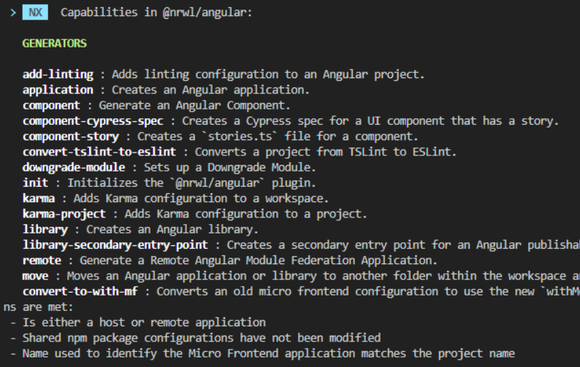
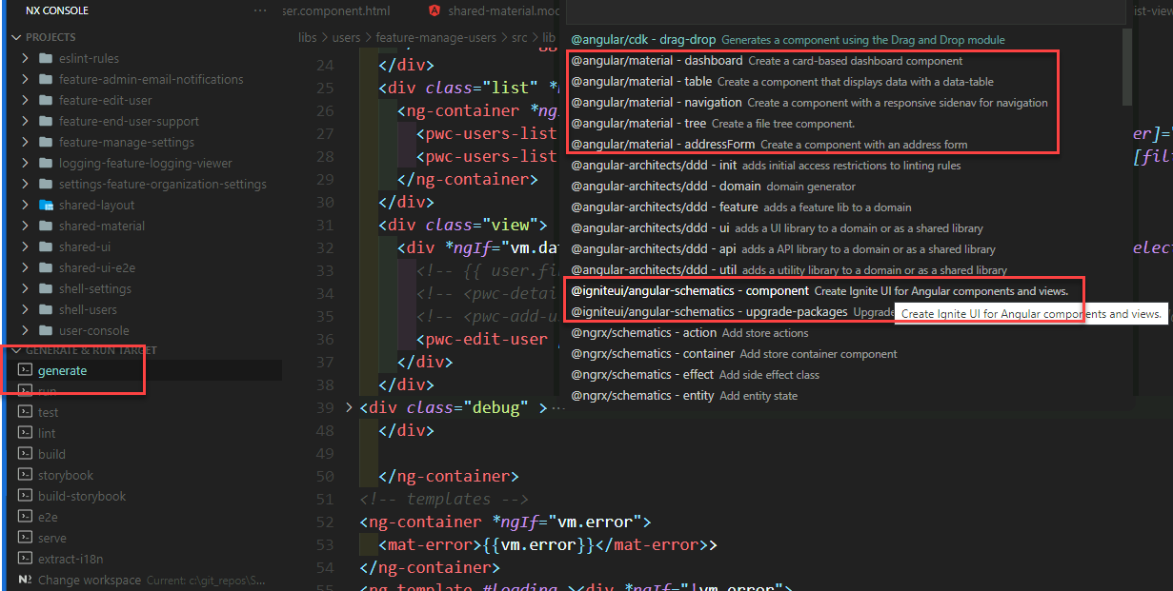
Nx Plugin Generators
Notes:
Generators:
Generate apps or components

Slide 34
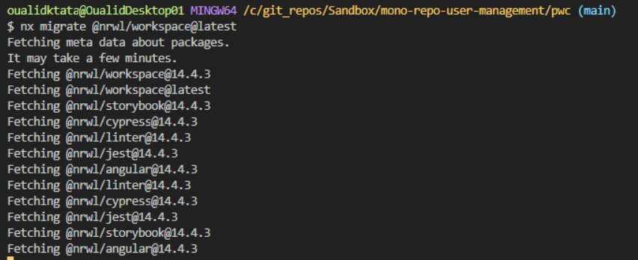
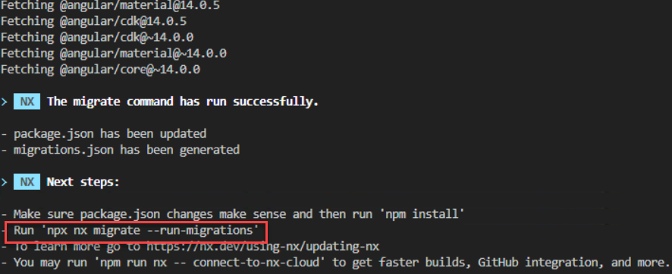
Update generators: migration

Slide 35
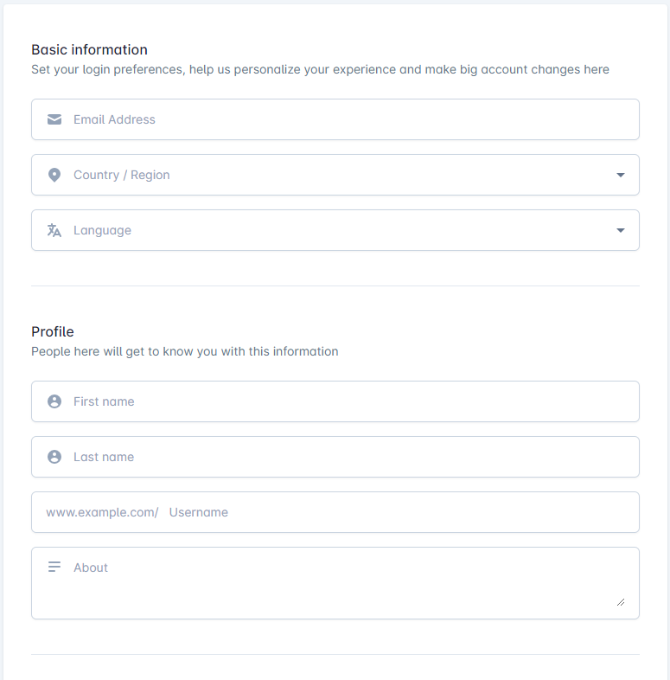
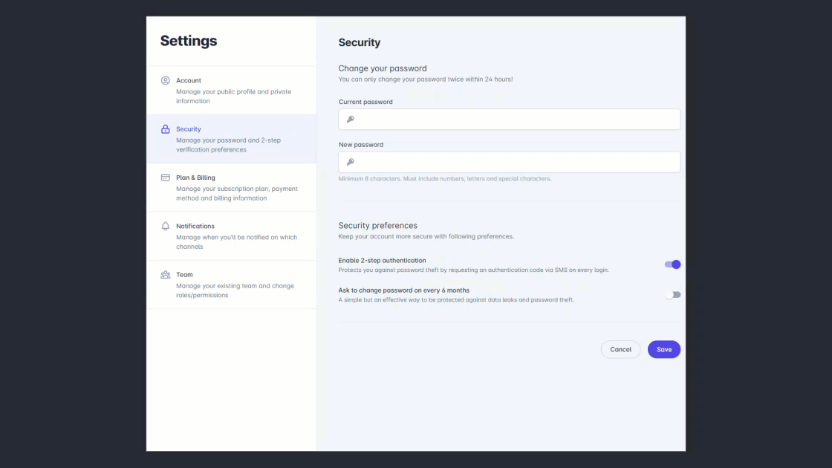
Custom Generators: Endless possibilities & huge value!
nx g @pwc/page:form –withSections
nx g @pwc/feature:master-detail –style=left-right –sample=yes
nx g @pwc/page:form –withSections –file=userProfile.json

Slide 36



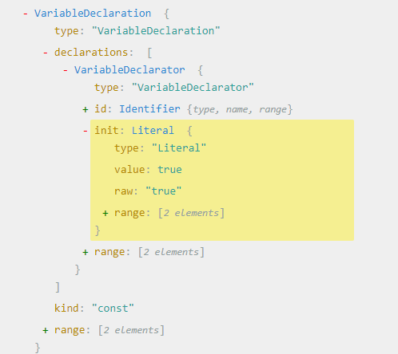
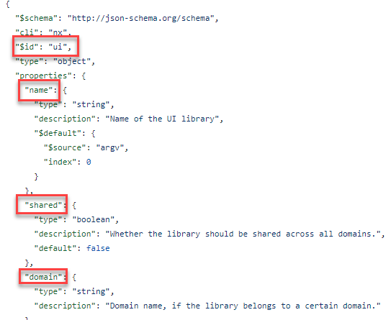
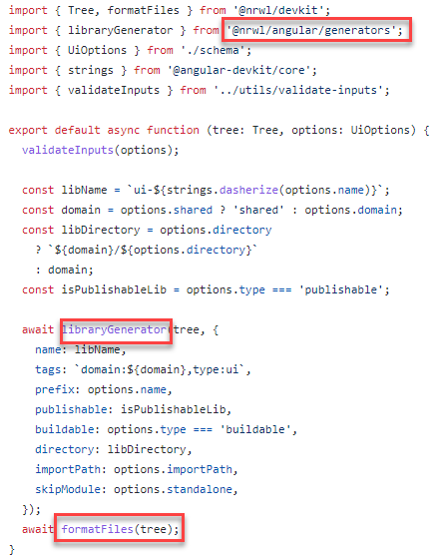
What you need ?
Workspace virtual tree
Schema: parameters
Generator function

Slide 37




Next- related subjects
Architecture (in)
DevOps (out)
Governance(out)

Slide 38

Questions
Before voting

Slide 39
Voting time!

Slide 40
Thank you

